Slide 1

D.Y. PATIL COLLEGE OF ENGINEERING & TECHNOLOGY,
KASABA BAWADA, KOLHAPUR
Semester-I Presentation on
“Patient Health Information Exchange Using Blockchain ”
Presented by
Sr. No. Roll No. Name
1. 21. Pranali Goraksh Kale
2. 22. Swati Bhanudas Bagal
3. 23. Aarya Rahul Athane
4. 24. Ashish Ashok Sangar
5. 25. Prathamesh Santosh Mahadik
Under the guidance of
Mr. A. J. Jadhav
DEPARTMENT OF COMPUTER SCIENCE AND ENGINEERING
(2022-2023)
Class : B.Tech Division : A Batch : G5

Slide 2
INDRODUCTION
1

Slide 3
A health information system enables health care organizations to collect, store, manage, analyze, and optimize patient treatment histories and other key data.
When that medical information is shared between providers, it happens by mail, fax or most likely by patients themselves, who frequently carry their records from appointment to appointment. While electronic health information exchange cannot replace provider-patient communication, it can greatly improve the completeness of patient’s records, as past history, current medications and other information is jointly reviewed during visits.

Slide 4
Problem Statement
Electronic health information exchange (HIE) allows doctors, nurses, pharmacists, other health care providers and patients to appropriately access and securely share a patient’s vital medical information electronically—improving the speed, quality, safety and cost of patient care.

Slide 5
What is Block Chain ?
Blockchain is a chain of blocks that are connected together and are continuously growing by storing transactions on the blocks.
BlockChain uses a decentralized approach that allows the information to be distributed and that each piece of distributed information or commonly known as data have shared ownership.

Slide 6
Why BlockChain For PHIE?
1)INTEROPERABILITY : The information should be exchangeable and must be usable for further purposes. In Health Information Exchange (HIE) or in general data sharing aspect.With a number of EHR systems being deployed in various hospitals they have a varying level of terminologies, technical and functional capabilities which makes it to have no universally defined standard.
2)INFORMATION ASYMMETRY : The information is centralized to only a single healthcare organization and its control is only provided to the hospitals organization. If a patient wants to access his medical records he would have to follow a long and tedious process to access them.
                3)DATA BREACHE : Data breaches in healthcare sector also calls for the need of a better platform.

Slide 7
Why BlockChain For PHIE?
4)DECENTRALIZATION :With blockchain the information is distributed across the network rather than at one central point. It makes the control of information to be distributed and handled by consensus reached upon by shared input from the nodes connected on the network.
5)DATA TRANSPARENCY :The data or record at stake should be secured and temper proof. Any data being stored on the blockchain is not concentrated at one place and is not controlled by one node but is instead distributed across the network. The ownership of data is now shared and this makes it to be transparent and secure from any third party intervention.
6)SECURITY AND PRIVACY: Blockchain technology uses cryptographic functions to provide security to the nodes connected on its network. It uses SHA-256 cryptographic algorithm on the hashes that are stored on the blocks.

Slide 8
OBJECTIVES
2

Slide 9
1)To improve quality of care by providing more complete patient information to enhance medical decision making.
2)To begin to reduce costs through the elimination of unnecessary duplicate tests.
3)To support continuity of care as patients transfer among health care facilities, an aspect growing in importance with the aging population.
4)To improve the information flow to health departments and facilitated stronger management of emerging infectious diseases.
5)To offer innovative ways to conduct population-based research through large databases created by some health information exchange organizations (HIO’s).
6)Despite the conventional methods of storing the data on paper, the electronic health care information helps share the communication between the providers through mails, fax, or patients themselves, without any need to carry the information from appointment to appointment.

Slide 10
Why BlockChain For PHIE?
1)INTEROPERABILITY : The information should be exchangeable and must be usable for further purposes. In Health Information Exchange (HIE) or in general data sharing aspect.With a number of EHR systems being deployed in various hospitals they have a varying level of terminologies, technical and functional capabilities which makes it to have no universally defined standard.
2)INFORMATION ASYMMETRY : The information is centralized to only a single healthcare organization and its control is only provided to the hospitals organization. If a patient wants to access his medical records he would have to follow a long and tedious process to access them.
                3)DATA BREACHE : Data breaches in healthcare sector also calls for the need of a better platform.

Slide 11
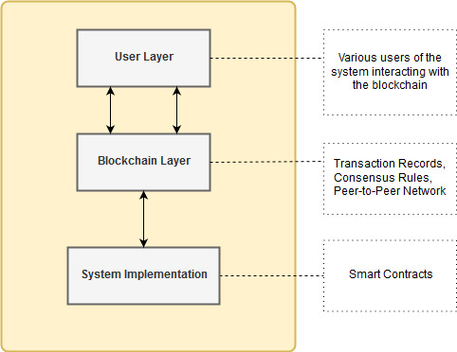
SYSTEM DESIGN AND ARCHITECTURE

Slide 12
System Design
As visible in above figure, the proposed framework or system has three modules. These modules when combined together would keep our system working. These modules have further concepts that need to be understood they are explained as follows.

Slide 13
ADMIN MODULE
Admin Can:
Add Doctor to the Network
Add Patient to the Network
Delete User(Doctor/Patient)

Slide 14
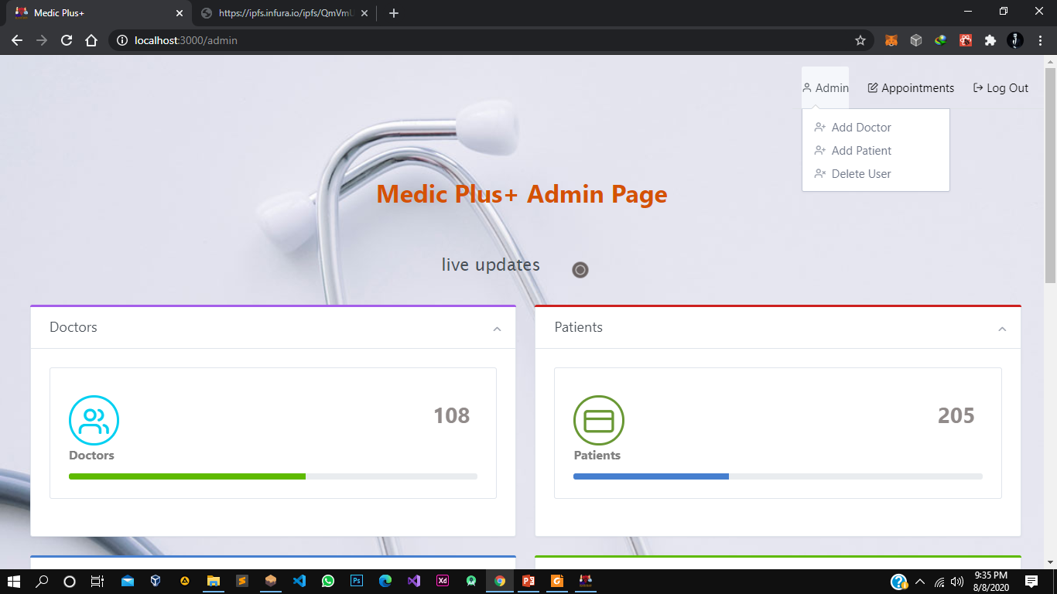

Slide 15
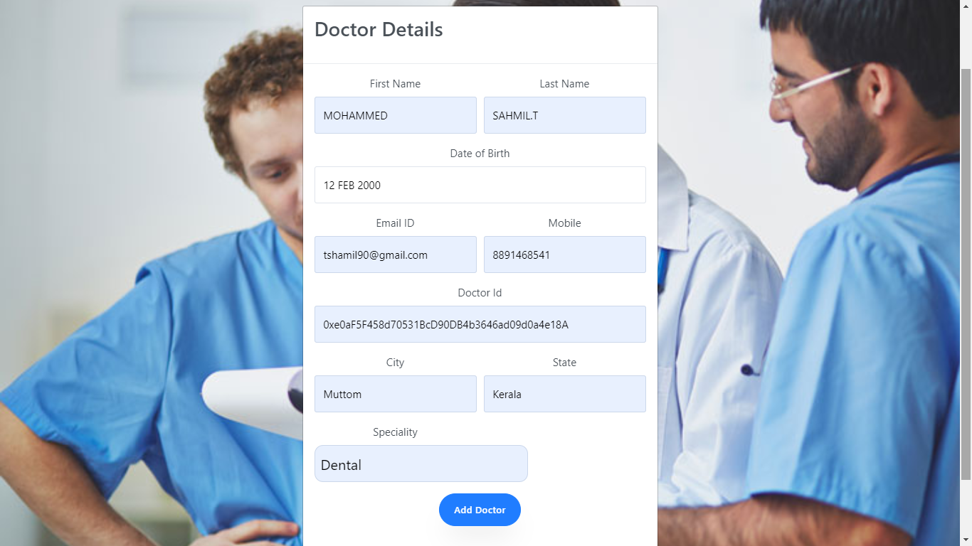
Add Doctor Function

Slide 16
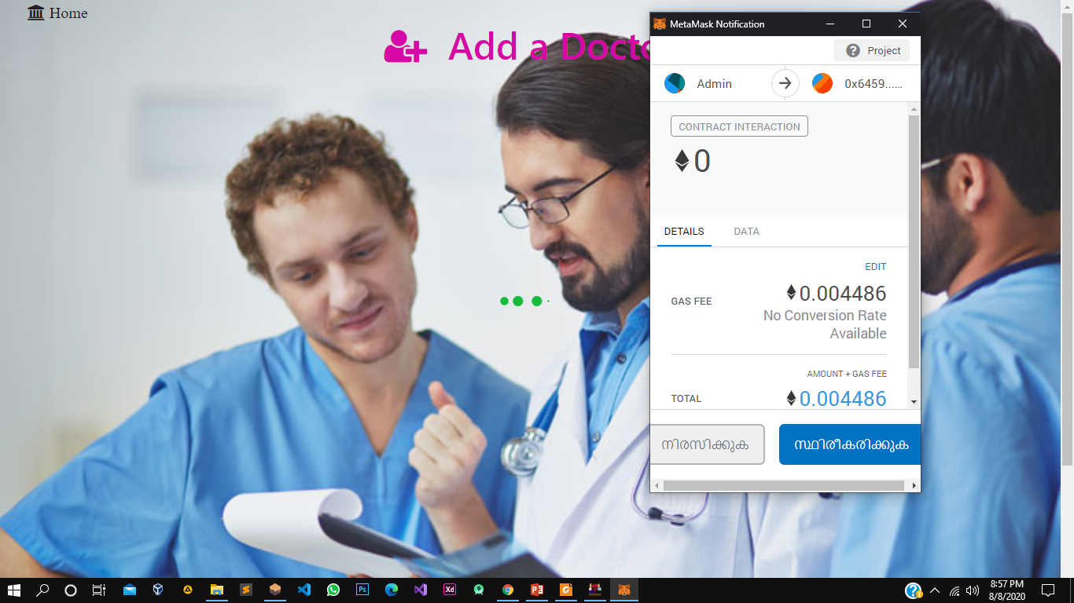
This transaction will cost some Ethers and we need to verify the transaction

Slide 17
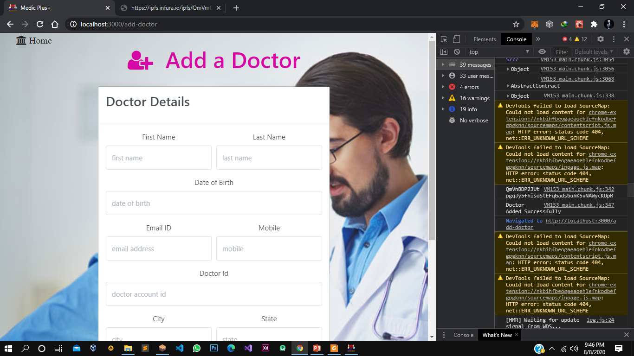
Now this account have access to doctor’s functions.
The Doctor Details are Converted to a JSON object and Uploaded to IPFS and IPFS hash is stored in BlockChain

Slide 18
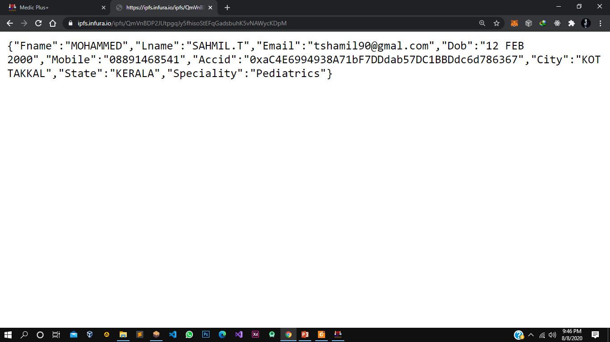
We can retrieve the IPFS Data with the Hash, JSON objects will be returned
The Same way Admin can add Patients

Slide 19
THANKS!

